Slide 1

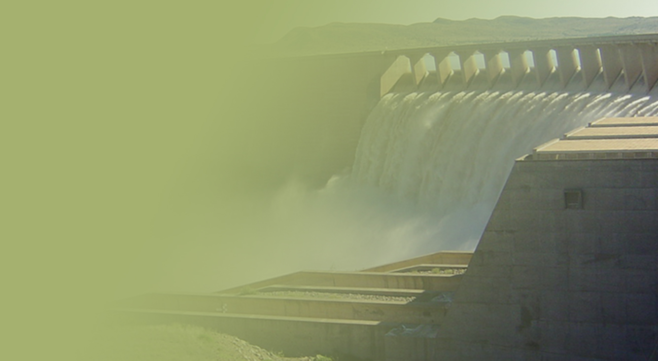
Support of the Water Reconciliation Strategy for the Algoa Water Supply System
ATSG Meeting
Aurecon
15 August 2018
PRESENTATION TITLE
Presented by:
Name Surname
Directorate
Date

Slide 2
Feasibility evaluation: Additional balancing storage in the LSRGWS

Slide 3
Balancing Dam Options
Following preliminary screening, costing and comparison:
Construction of a 4.6 million m³ balancing dam near present Scheepersvlakte Dam & integration with existing gravity pipeline to Nooitgedagt WTW:
Lower Coerney Dam
Upper Scheepersvlakte Dam

Slide 4
Construction of a larger dam near the present Scheepersvlakte Dam site
Both sites falls on land being planned for development by the Scheepersvlakte 98 Citrus Development Trust
The Trust agreed to co-operate with the DWS and possible future works, should the new dam option be pursued further
The dam will be sized for the combined NMBM balancing capacity of 4 410 Mℓ (21 days balancing storage) plus the Developer’s required irrigation capacity (~ 180 Mℓ, one week of storage)

Slide 5
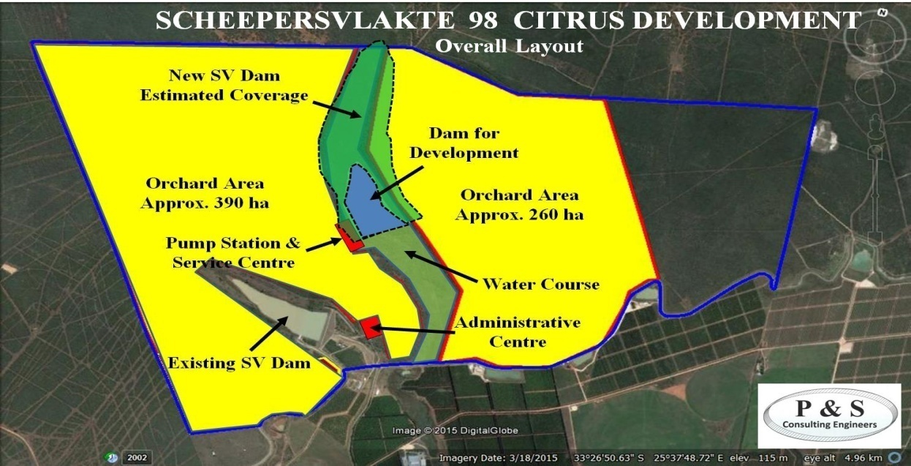
Scheepersvlakte Farm & dam locations

Slide 6
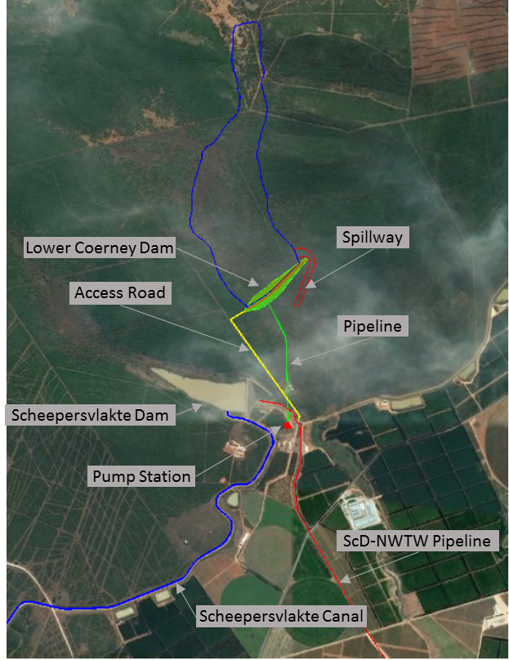
  Lower Coerney Dam

Slide 7
Next Steps
Draft EIA scope of work provided with notes
Detailed geotechnical evaluation to assess suitability of short-listed dam sites is underway:
  Geophysical survey – complete
  Test pitting – mostly complete (access constraints)
  Rotary core drilling – establish week of 20 Aug
  Lab testing – initial analysis done
  Data analysis, interpretation and reporting
Topographical site survey of selected dam site done:
  Done by DWS NWRI survey team
  Small additions to be surveyed for pipework area
Flood assessment for Lower Coerney Dam
Reserve determination for Lower Coerney Dam

Slide 8
WUE assessment - Fish and Sundays catchments

Slide 9
Project objectives
Algoa Recon Strategy Support: To put in place arrangements and resources for ongoing implementation of the recommendations and maintenance of the Algoa Reconciliation Strategy.
Evaluation of Water Use and Allocation in the OFS System: To evaluate the efficiency of the Eastern Cape Province Orange River Project.
Additional Balancing Storage for NMBM: To remove potential operating system constraints for sustainable delivery of bulk Orange River water supply to the Lower Sundays River Government Water Scheme (LSRGWS) and to Nelson Mandela Bay Municipality (NMBM), for water requirements up to 2040.

Slide 10
Recommended WUE Savings
Recommended Intervention | Potential Water Savings (million m³/a)
Reduce allowance for canal losses in the GFRWUA (incl. clearing of vegetation along canals & lining of “hot spot” priority canal sections) | 40
Reduced operational releases at Elandsdrift & De Mistkraal Weirs | 31
Rehabilitation of Darlington Dam & reducing spills at Korhaansdrift Weir | 18
Improve measuring and monitoring systems | Not quantified
Estimated savings: | 89 million m³/a
Notes:
Final recommendations will be made for the reallocation of the potential water savings in the Alternative Reallocation Options sub-report.

Slide 11
Conclusions
No savings foreseen from WC/WDM at small towns or diversion at Hermanuskraal Weir to Makana LM & Tyhefu Irrigation Scheme
Avoid future under-utilisation of water from emerging farmers allocations, by learning from proven, sustainable emerging-farmer developments, to ensure the best possible chance of success
Phased implementation of recommended WUE interventions
Continuously monitor actual water savings realized & adjust savings targets

Slide 12
Distribution of targeted savings
Proposed distribution of saved water | 2040 Target (million m³/a)
Reduced Orange River transfer volume to Eastern Cape | 64
Small towns to apply for further allocations | 7
NMBM to apply for further allocations | 18
Total | 89
Notes:
Final recommendations will be made for the reallocation of the potential water savings in the Alternative Reallocation Options sub-report.

Slide 13
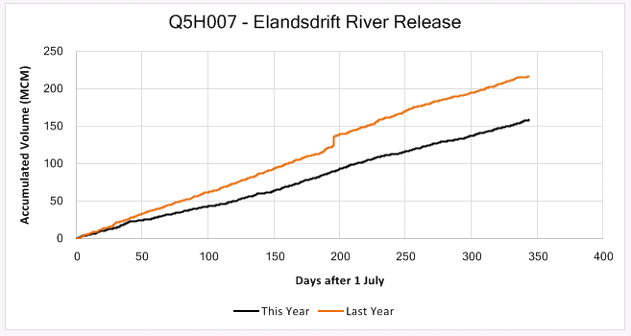
Comparison of operational releases at Elandsdrift Weir
OFS Real-time Model
: Great Fish River
55 million m³ less
2017/18
2016/17

Slide 14
AWSS Status Report

Slide 15
Presentation Content
Water availability and requirements
Interventions
Scenario planning

Slide 16
Water Availability

Slide 17
Priority classes for different category water users
Category | % of total water requirement allocated to indicated priority class and acceptable risk of non-supply (assurance of supply)
 | 1: 100⁽¹⁾ year (99%) | 1: 50 year (98%) | 1: 10 year (90%) | 1: 5 year (80%)
Irrigation Gamtoos | 30 | 20 | 20 | 30
Irrigation Other | 20 | 20 | 20 | 40
Urban | 50 | 20 | 20 | 10
Losses | 100 | 0 | 0 | 0
Environmental | 100 | 0 | 0 | 0
It is preferable that all irrigators receive the same priority water throughout the AWSS

Slide 18
Groundwater
Summary of potential groundwater yields used in strategy
Groundwater intervention | Lower estimate (million m³/a) | Upper estimate (million m³/a) | Assumed yield (million m³/a)
Coega Fault | 6 | 8 | 8
Churchill Dam | 2 | 4 | 3
Moregrove Fault | 0.8 | 1.6 | 1
Bushy Park | 2 | 4 | 4
Jeffreys Arch | 6 | 9 | 7
Van Stadens | 4 | 4 | 4
Gamtoos Valley | 2 | 4 | 3
Kruisrivier | 0.4 | 1 | 0.5
Total | 23.2 | 35.6 | 30.5

Slide 19
Groundwater
Estimated borehole yields for NMBM from currently-planned boreholes
Area | Aquifer | Production boreholes | Mℓ/day | million m³/a
Wellfields
Coega Kop | Coega Fault - TMG | 5 | 13.0 | 4.7
Uitenhage | Coega Fault -TMG | 4 | 5.2 | 1.9
Churchill Dam (NMBM property) | Folded TMG | 12 | 5.2 | 1.9
Bushy Park (West) | TMG | 12 | 5.2 | 1.9
Moregrove | Moregrove Fault - TMG | 21 | 9.1 | 3.3
Total wellfields |  | 60 | 37.6 | 13.7
Individual boreholes
Individual Boreholes | Mostly TMG | 102 | 13.2 | 4.8
Total wellfields & individual Bhs |  | 162 | 50.8 | 18.5
Churchill Dam (CHD Pipeline) | Folded TMG | 6 | 4.1 | 1.5
Potential Total |  | 168 | 55 | 20

Slide 20
Groundwater
Kouga Municipality – potential yields of recently drilled production boreholes
Town | Existing sources | Newly drilled production boreholes | Ml/day | million m³/a
Oyster Bay | Boreholes & springs | 2 | 0.2 | 0.06
Jeffreys Bay | Dams & boreholes | 2 | 0.8 | 0.30
Humansdorp | Dams, springs & boreholes | 2 | 0.8 | 0.30
Hankey | Dam | 1 | 0.9 | 0.31
Patensie/ Andrieskraal | Dam | 4 | 0.4 | 0.14
Total |  |  | 3.1 | 1.11

Slide 21
Algoa WSS water availability
Yield at 1:50 yr assurance of supply
Transferred Orange River water: yield increased following completion of Phase 2 of the Nooitgedagt Low Level Scheme, from 32.9 million m³/a (90 Ml/d) to 50.0 million m³/a (137 Ml/d)
Low confidence in the yields of the Kromme & Kouga sub-systems sub-system to be addressed in the Kouga-Kromme WAAS once the V&V study is complete
No change in yield of the Algoa WSS from 2017 analysis
Emergency drought infrastructure upgrades to NCLLS not considered

Slide 22
Water supply from the Algoa WSS
Long-term stochastic yields of the Algoa WSS:
Sources of supply | 1 in 50 year yield or existing allocation/use
 | (million m³/a) | (Ml/d)
NMBM older dams | 3.4 | 9.3
Groendal Dam | 6.8 | 18.6
Uitenhage Springs and boreholes | 2.2 | 6.0
Churchill/Impofu dams | 30.0 | 82.2
Kouga/Loerie dams | 75.0 | 205.5
Sundays River GWS transfer | 50.0* | 137
Combined Total Yield | 167.4 | 458.6
* Excludes interim yield achieved through emergency drought infrastructure added

Slide 23
Water Use, Requirements and Balance

Slide 24
Historical Use from the Algoa WSS
% linear growth pa 1.3%
Trendline growth pa 2.3%

Slide 25
Historical Use from the Algoa WSS
Drought year

Slide 26
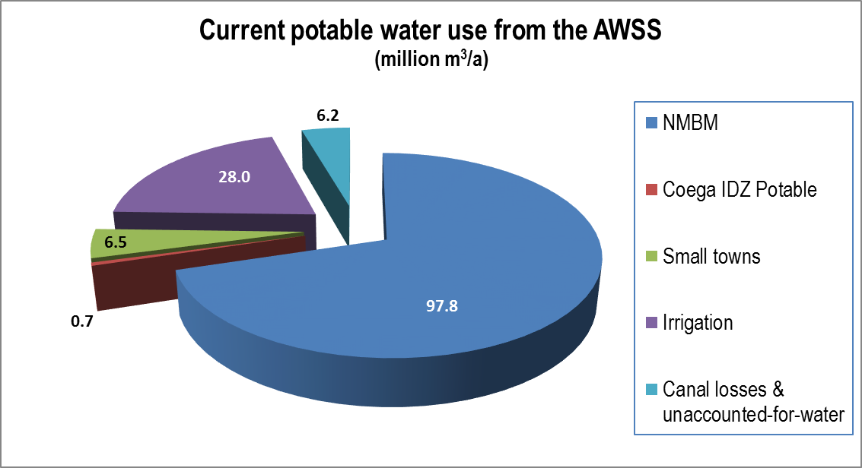
2017/18 Use from the Algoa WSS
TOTAL 139.1 million m³/a

Slide 27
2017/18 Use from the Algoa WSS
million m³/a
NMBM | Kouga LM | Hankie & Patensie | GIB | Groendal irrigation | Impofu Dam irrigation | Canal losses | TOTAL USE
97.8 | 5.38 | 1.1 | 23.6 | 2.4 | 2.0 | 6.2 | 139.1
Allocation of 4.5 million m³/a
Plus Coega SEZ potable use of 0.7 million m³/a

Slide 28
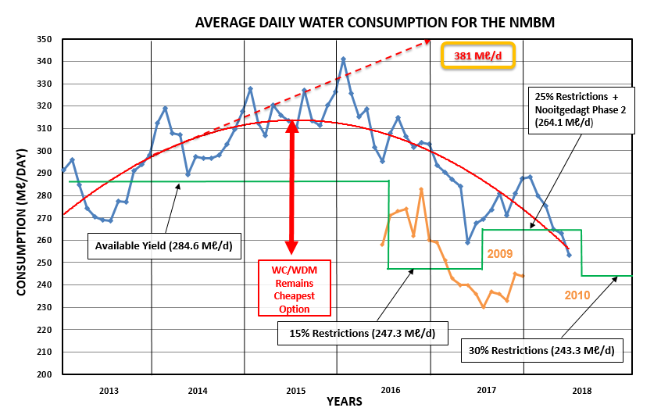
Historical NMBM Average Daily Use

Slide 29
Water Use Conclusions
The 2017/18 water use was severely restricted because of the drought
Gamtoos IB was especially negatively affected
Coega SEZ potable use still very low. No industrial water use
Water use exceeded allocations for Kouga LM
More severe restrictions to be implemented

Slide 30
Future Water Requirements

Slide 31
Water Requirement Scenarios
7 Water Requirement Scenarios developed - combinations of:
  Low growth of 1% compound growth
  Historical long-term growth of 2.3%
  High growth of 3.5% linear growth
  Coega IDP domestic & industrial water projections
  For Kouga LM linear growth of 3.3% high-growth used to be in line with DWS growth estimations
  Implementation of the Reserve
  Climate change
Base year value used for projections is theoretical, to avoid under-estimation of interventions required

Slide 32
Coega IDZ Water Requirements

Slide 33
Base year value for Scenarios
2017/18 historical water use value NOT used as starting point for scenario planning, because:
  2017/18 historical value reflects restricted use of the Algoa WSS during a significant drought
  Using this value as the starting point for scenario planning will lead to under-estimation of the interventions needed to ensure a long-term water balance
  Water use typically returns to pre-drought levels within a year or two, unless some drought WC/WDM measures are kept in place
Theoretical starting value corresponding closely with trendline value of historical use used for scenario projections
  2017/18 actual (restricted use) was 139.1 million m³/a
  2017/18 Scenario starting value is 169.4 million m³/a

Slide 34
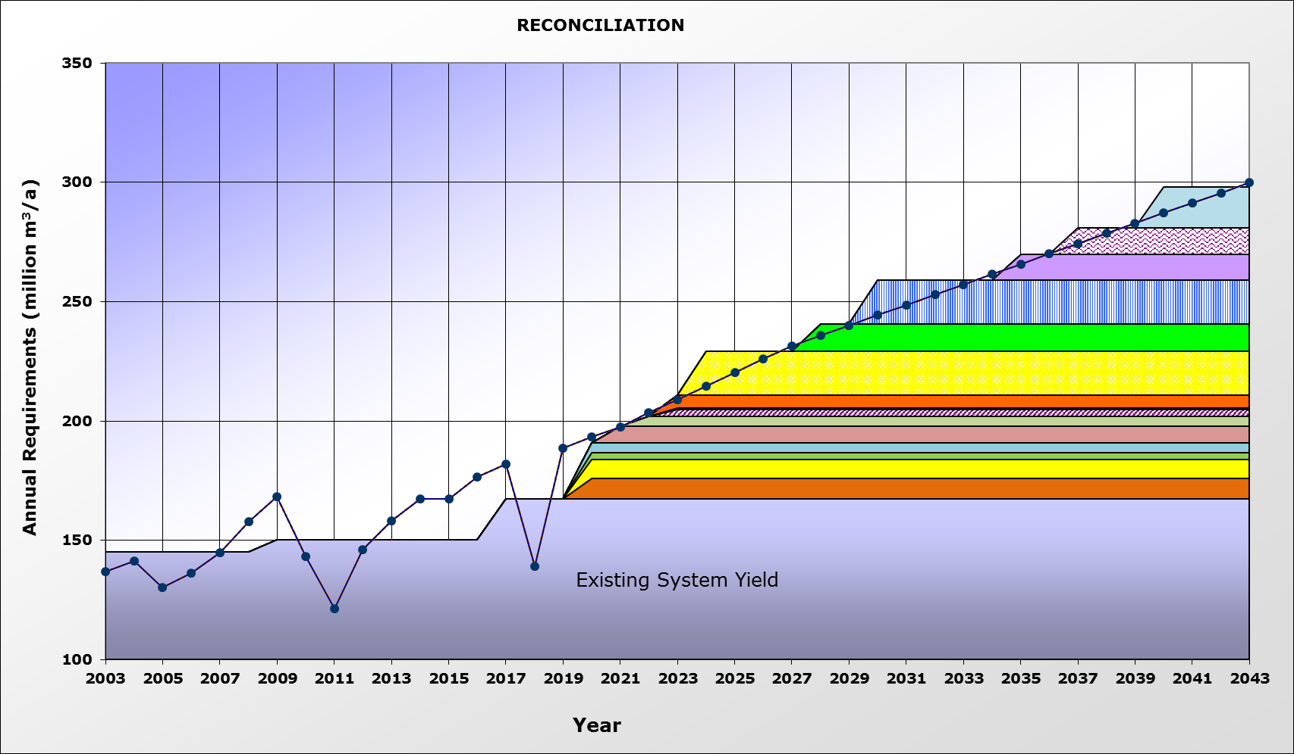
Influence of starting value on Scenario Planning
Difference in future water demand to plan for at linear growth
4 less schemes identified
Theoretical starting value 2017/18
Kouga dam replacement / raising
Seawater Desal Ph 2
Seawater Desal Ph 1
NLLS Phase 5
Actual 2017/18 use
Lower Sundays Return Flows
NLLS Phase 4
Desal – Marina Sea Salt
5 groundwater schemes
Groundwater Coega Fault
Nooitgedagt Low Level Scheme Phase 3

Slide 35
Interventions

Slide 36
Interventions Considered for Scenario Planning
WC/WDM: 5%, 10% & 15% savings
Nooitgedagt-Coega Low Level Scheme: Phases 3, 4 & 5
Effluent treated to industrial and/or potable standards
  Fish Water Flats WWTW Reuse, phased
  Coega WWTW Reuse, phased
Coega Kop & various other groundwater schemes
Lower Sundays River return flows
Seawater Desalination: Marina Sea Salt, NMBM (phased)
Raising of Kouga Dam / Guernakop Dam

Slide 37
Changes to Interventions
Further allocation of Orange River water to NMBM
  NLLS Phase 4 – DWS has confirmed in-principle approval for NMBM to apply for additional 18.25 million m³/a (50 Ml/d), based on savings from WUE efficiency measures introduced in Great Fish & Sundays catchments - equivalent to difference between average flow and peak flow of the NCLLS Phase 3, i.e. 210 – 160 = 50 Mℓ/day.
  NLLS Phase 5 added – assumed further allocation from savings achieved, of 18.25 million m³/a (50 Mℓ/d), but this depends on the actual efficiency savings to be achieved

Slide 38
Scenario Planning

Slide 39
Scenarios Developed
Scenario Planning up to 2043
Coega Industrial Water Requirements
Low Growth including Coega Potable: 1% compound growth + Coega potable
2.3% Growth including Coega Potable without WC/WDM
High Growth Potable (Reference): 3.5% linear growth + Coega potable
High Growth Potable without WC/WDM: 3.5% linear growth + Coega potable (no efficiency saving from WC/WDM)
High Growth including Coega: 3.5% linear growth + Coega potable and industrial
Worst Case: 3.5% linear growth + Coega potable and industrial, with climate change & implementation of the Reserve

Slide 40
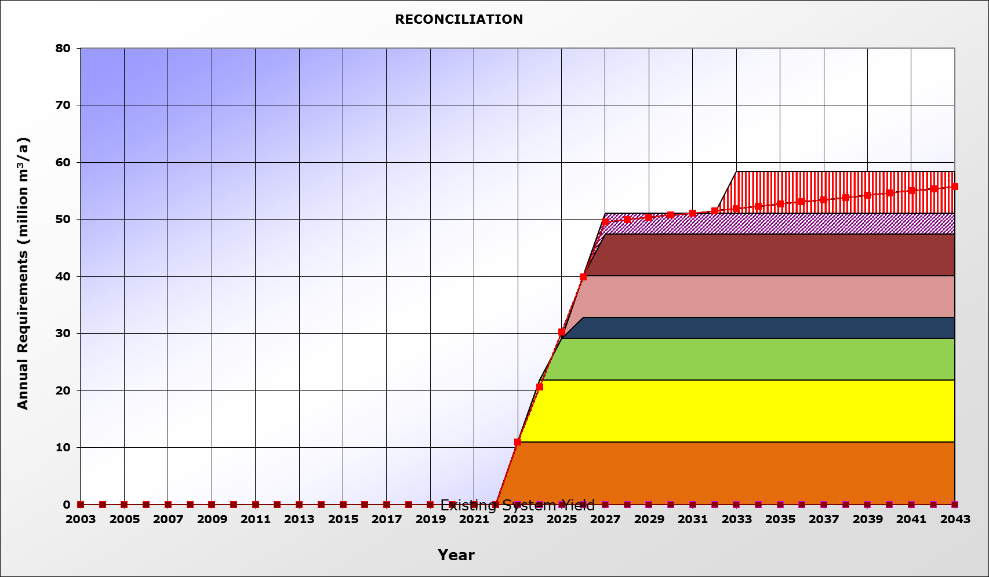
1. Coega Industrial Water Requirements
Coega WWTW Industrial Reuse Ph 4 Ind
Coega WWTW Industrial Reuse Ph 3 ind
Coega WWTW Industrial Reuse Phase 3 pot
Coega WWTW Industrial Reuse Ph 2 Ind
Coega Industrial water requirements
Coega WWTW Industrial Reuse Ph 2 pot
Coega WWTW Industrial Reuse Ph 1 pot
FWF WWTW Industrial Reuse Ph 2
FWF WWTW Industrial Reuse Ph 1

Slide 41
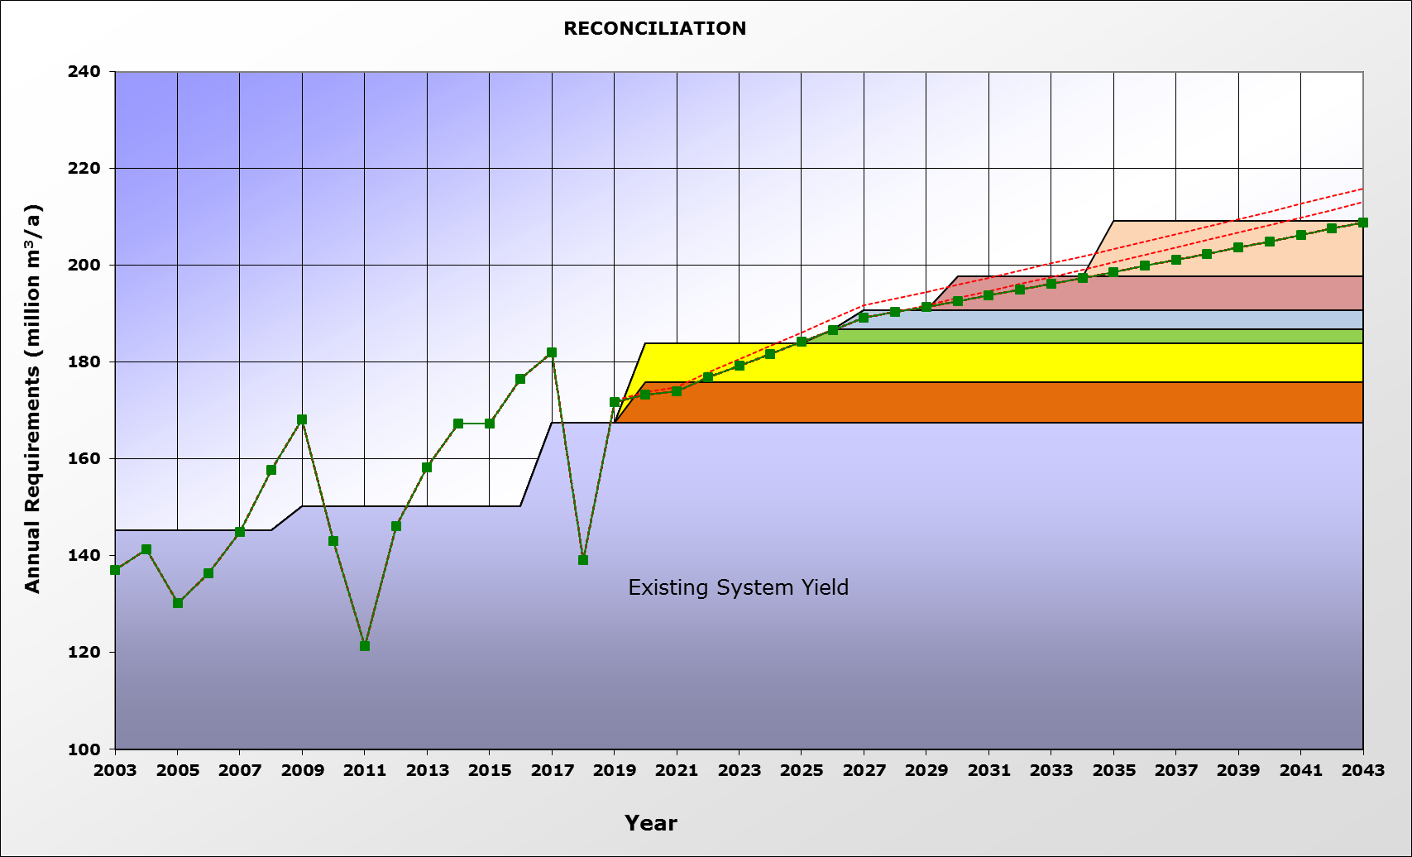
2. Low Growth including Coega Potable
Requirement = 1% compound growth + Coega potable
15% WC/WDM
15% WC/WDM
Lower Sundays Return Flows
3 groundwater schemes
Groundwater Coega Fault
Nooitgedagt Low Level Scheme Phase 3

Slide 42
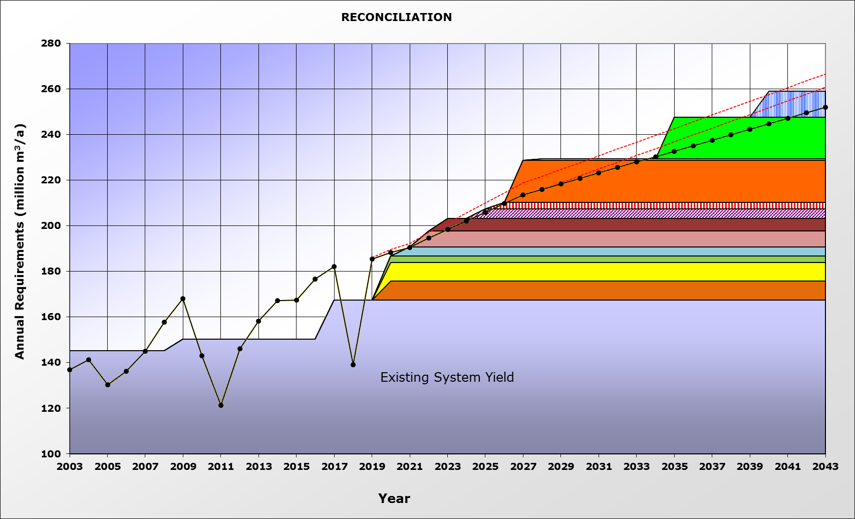
3. 2.3% Historical growth w/o WC/WDM
15% WC/WDM
Lower Sundays Return Flows
Requirement = 3.5% linear growth + Coega potable
15% WC/WDM
NLLS Phase 5
NLLS Phase 4
2 groundwater schemes
Desal – Marina Sea Salt
3 groundwater schemes
Groundwater Coega Fault
Nooitgedagt Low Level Scheme Phase 3

Slide 43
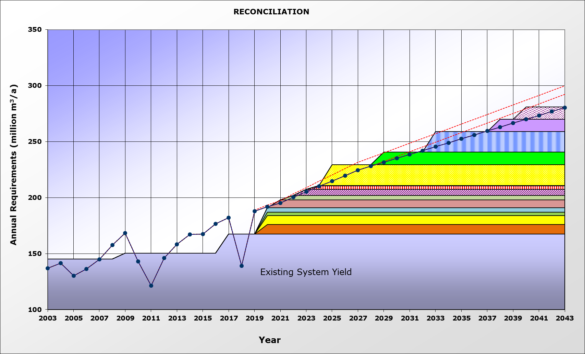
4. High Growth Potable Scenario (Reference)
15% WC/WDM
15% WC/WDM
Seawater Desal Ph 2
Requirement = 3.5% linear growth + Coega potable
Seawater Desal Ph 1
NLLS Phase 5
Lower Sundays Return Flows
NLLS Phase 4
Groundwater scheme
Desal – Marina Sea Salt
5 groundwater schemes
Groundwater Coega Fault
Nooitgedagt Low Level Scheme Phase 3

Slide 44
5. High Growth Potable without WC/WDM
Kouga dam replacement / raising
Seawater Desal Ph 2
Requirement = 3.5% linear growth + Coega potable
Seawater Desal Ph 1
NLLS Phase 5
Lower Sundays Return Flows
NLLS Phase 4
Desal – Marina Sea Salt
5 groundwater schemes
Groundwater Coega Fault
Nooitgedagt Low Level Scheme Phase 3

Slide 45
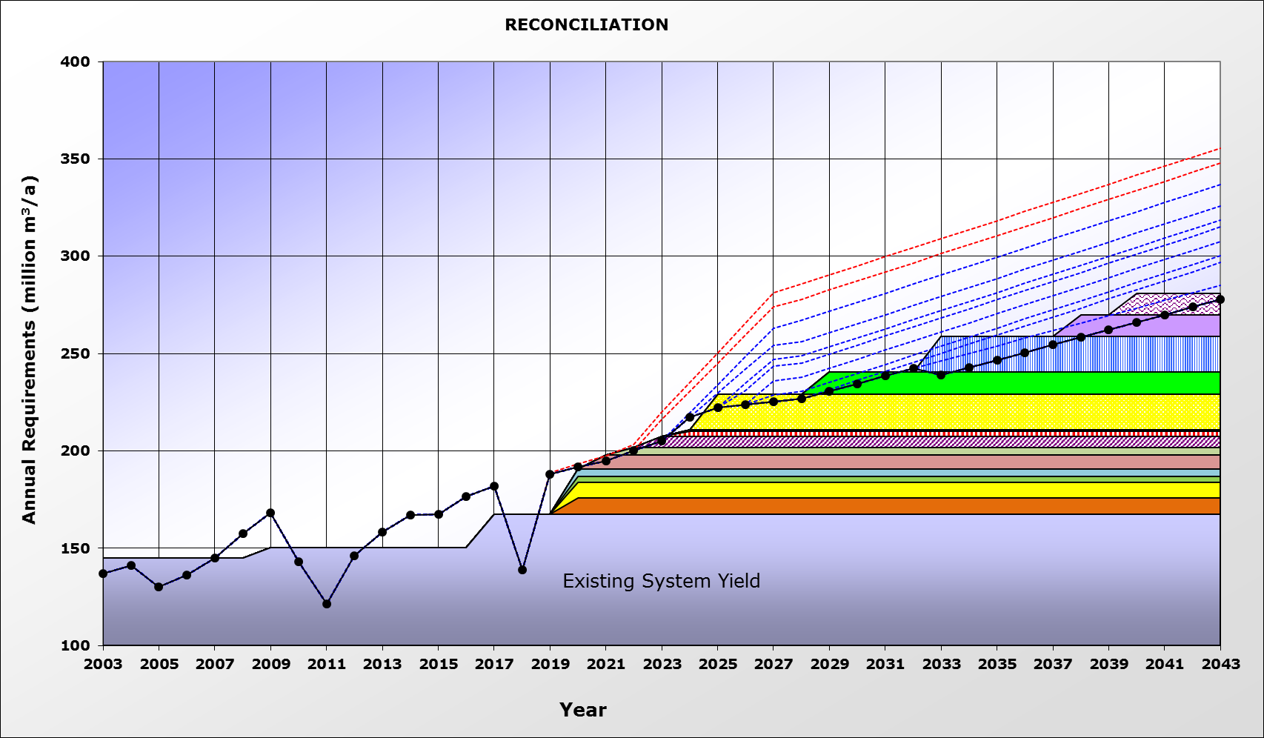
6. High Growth including Coega (pot & ind)
15% WC/WDM
Reuse Coega – ex FWF WWTW
Reuse Coega – ex Coega WWTW
Reuse Coega – Coega WWTW
Requirement = 3.5% linear growth + Coega pot & ind
15% WC/WDM
Desal Phase 2
Desal Phase 1
NLLS Phase 5
Lower Sundays Return Flows
NLLS Phase 4
Groundwater scheme
Desal – Marina Sea Salt
4 Groundwater schemes
Groundwater Coega Fault
Nooitgedagt Low Level Scheme Phase 3

Slide 46
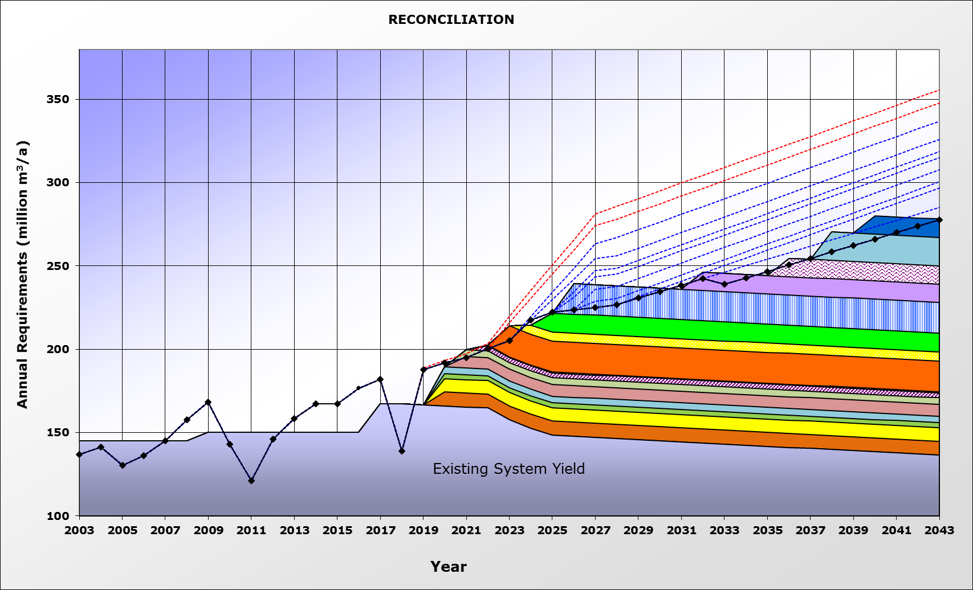
7. Worst Case Scenario
15% WC/WDM
Reuse Coega – ex FWF WWTW
Reuse Coega – ex Coega WWTW
Reuse Coega – ex Coega WWTW
Requirement = 3.5% linear growth + Coega pot & ind
15% WC/WDM
Seawater Desal Ph 3
Kouga dam replacement / raising
Seawater Desal Ph 2
Seawater Desal Ph 1
NLLS Phase 5
Lower Sundays Return Flows
Desal – Marina Sea Salt
NLLS Phase 4
5 groundwater schemes
Groundwater Coega Fault
Nooitgedagt Low Level Scheme Phase 3

Slide 47
Scenario Conclusions
Current shortages caused by drought
Delayed funding of infrastructure, procurement and implementation leads to risks of not meeting water requirements
Water efficiency measures and behaviour should be made more permanent
Effective WC/WDM essential for NMBM & Kouga LM
Complete NLLS Ph3 & remove bottlenecks in delivery
Planning of interventions should proceed due to long implementation lead times & uncertainty in terms of growth in water requirements
Groundwater schemes to be pursued by NMBM & Kouga LM (also forms part of drought actions)
Kouga LM likely to be become more self-sufficient

Slide 48
- Thank you -

